Slide 1
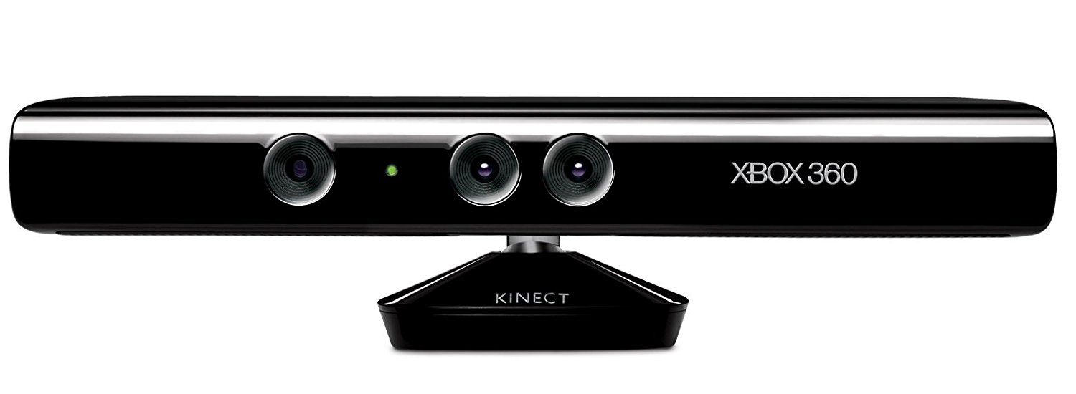

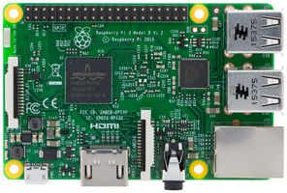


Slide 2
RGB-D Image
Freenect_Launch
RTAB-Map
RViz
ROS Core

Slide 3
